Slide 1





ManageIQ-Telefonica
2549 152nd NE Ave, Redmond 98052, WA USA.
Plot No. 21, IT Park, Wing - A, 1st Floor, Gayatri Nagar, Nagpur, Maharashtra 440022
North Taikoo Li, 11 Saniltun Road, TWR N3 3/F, Chaoyang, Beijing

Slide 2

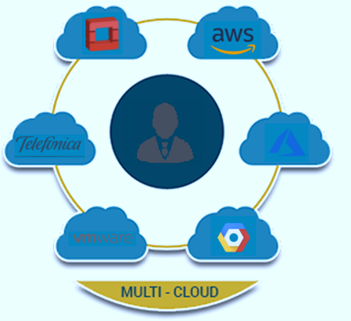
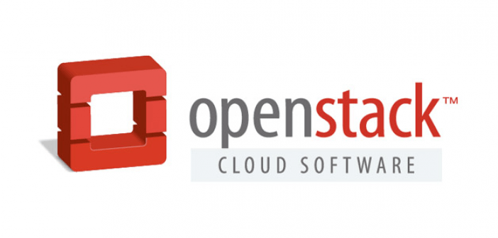


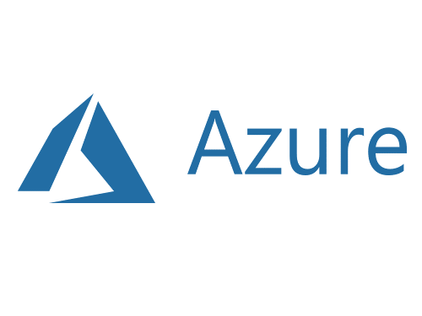



Agenda
Business Need and Proposed Solution
Benefits
How it works ?
Architecture
Developed Services
GitHub Integration
Future Roadmap
Enterprise Version of ManageIQ – Migration Studio
+
MULTI-CLOUD
Click2Cloud-ManageIQ-Telefonica
2
Notes:
Color changes

Slide 3

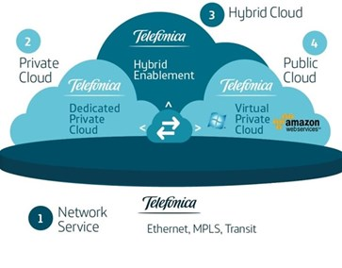






Business Need & Proposed Solution
Business Need
People were unable to manage today's diverse, heterogeneous environments of multiple clouds spread out all over the world.
Solution
Proposed Solution
ManageIQ is a multi CMP that can automatically discover VM environments wherever they are running and bring them all
under one management roof.
Workbench
APIs
Self Service
Compliance Enforcement
Optimisation
Administrator
Click2Cloud-ManageIQ-Telefonica
3

Slide 4
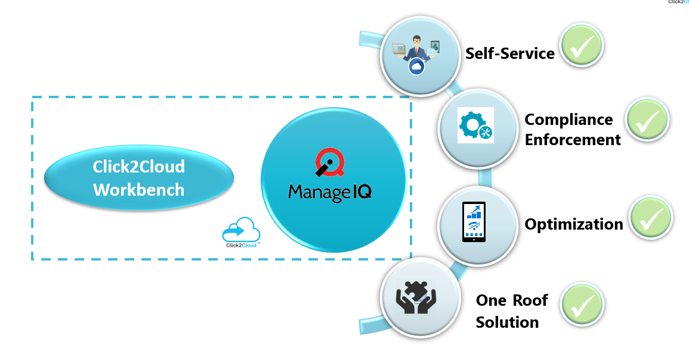
Benefits
Click2Cloud-ManageIQ-Telefonica
4

Slide 5
How it works ?
ManageIQ is a manager of managers and as such it needs to connect to other management systems to function. These other management systems are called providers in ManageIQ parlance.
1
2
3
4
5
ManageIQ will connect to the providers via their APIs.
ManageIQ will continuously discover inventory. Certain events that indicate a change in the environment will result in a full or partial refresh of the inventory.
The end result is a mirror of the inventory that is nearly instantaneously up to date with respect to the original inventory managed by the provider.
If configured to do so, ManageIQ will also capture metrics like CPU and memory usage on the discovered inventory.
All captured information about a managed environment is stored in a database called the Virtual Management Database (VMDB).
Click2Cloud-ManageIQ-Telefonica
5

Slide 6







Architecture
Click2Cloud Workbench
Providers
Provider
3
manageiq-api
Amazon
1
Azure
ManageIQ/ui-classic
API
ManageIQ/ui-service
Telefonica
End User
ManageIQ/ ui-component
OpenStack
2
Google
manageiq-schema
1
2
3
ui-classic, ui-service, ui-component are the ManageIQ’s centralized repositories.
Telefonica provider establishes the connection with Ruby SDK. It acts as an interface between ManageIQ and Ruby SDK.
Fog-OpenStack is a Ruby SDK which communicates with Telefonica cloud APIs.
Click2Cloud-ManageIQ-Telefonica
6

Slide 7




Developed Services
35+ Features
Developed For Telefonica
Network
Storage
Compute
Provision VM
Delete VM
Update VM flavor
List the flavor
Get VM information
Start VM/Stop VM
Restart VM
List the images
Attach a disk to an instance
Detach a disk from an instance
Get disk list of a VM
Create a VPC
Delete a VPC
Update a VPC
Get the VPC information
Create a Subnet
Delete a Subnet
Update the subnet information
Get the subnet
Create, Delete, List EIP, Get EIP information
Create, Delete, Update, List the security group
Create a disk
Delete a disk
Get the disk information
List all disks
Create a snapshot from a disk
Delete the snapshot
List the snapshot
Get the snapshot information
Click2Cloud-ManageIQ-Telefonica
7

Slide 8



GitHub Integration
Below are the ManageIQ official repositories where we will merge our developed code.
ManageIQ/manageiq
ManageIQ/ui-classic
ManageIQ/schema
ManageIQ/providers-Telefonica
3
3
1
2
1
Click2Cloud-ManageIQ-Telefonica
8

Slide 9
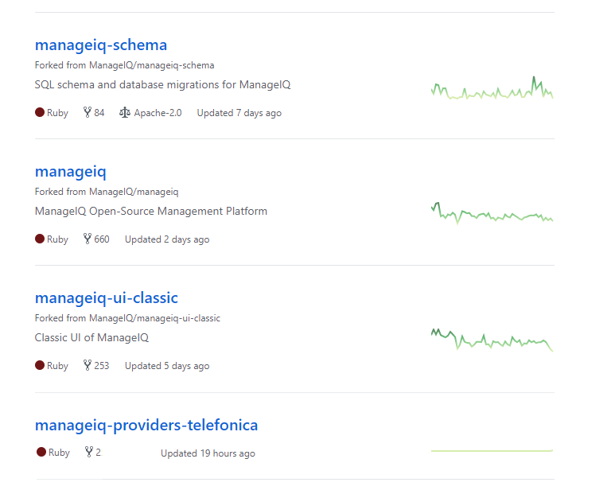
Click2Cloud Official GitHub Repository
https://github.com/Click2Cloud/manageiq-schema
https://github.com/Click2Cloud/manageiq
https://github.com/Click2Cloud/manageiq-ui-classic
https://github.com/Click2Cloud/manageiq-providers-telefonica.git
Click2Cloud-ManageIQ-Telefonica
9

Slide 10

Future Roadmap
Proposed Services
Storage
Object Storage
Control
Explorer Simulation
Import/Export Log
Automation
Ansible
Ansible Tower
Automate
Optimize
Utilization
Planning
Bottleneck
Network
Load Balancer
Compute
Containers
Migration
Click2Cloud-ManageIQ-Telefonica
10

Slide 11



Enterprise Version of ManageIQ – Migration Studio
Step1: Huawei/Telefonica will introduce to customer or will share customer use cases. Also, source and destination cloud access.
Step2: As MSP Click2Cloud will migrate workload on Huawei/Telefonica Cloud.
Step3: Click2Cloud will also provide post-migration support using ManageIQ-Enterprise version
Huawei / Telefonica Customers
Huawei/Telefonica ⇔ Click2Cloud
①Support each other
End Users
Click2Cloud-ManageIQ-Telefonica
11

Slide 12








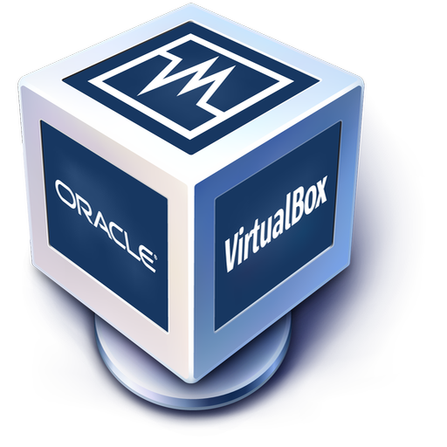
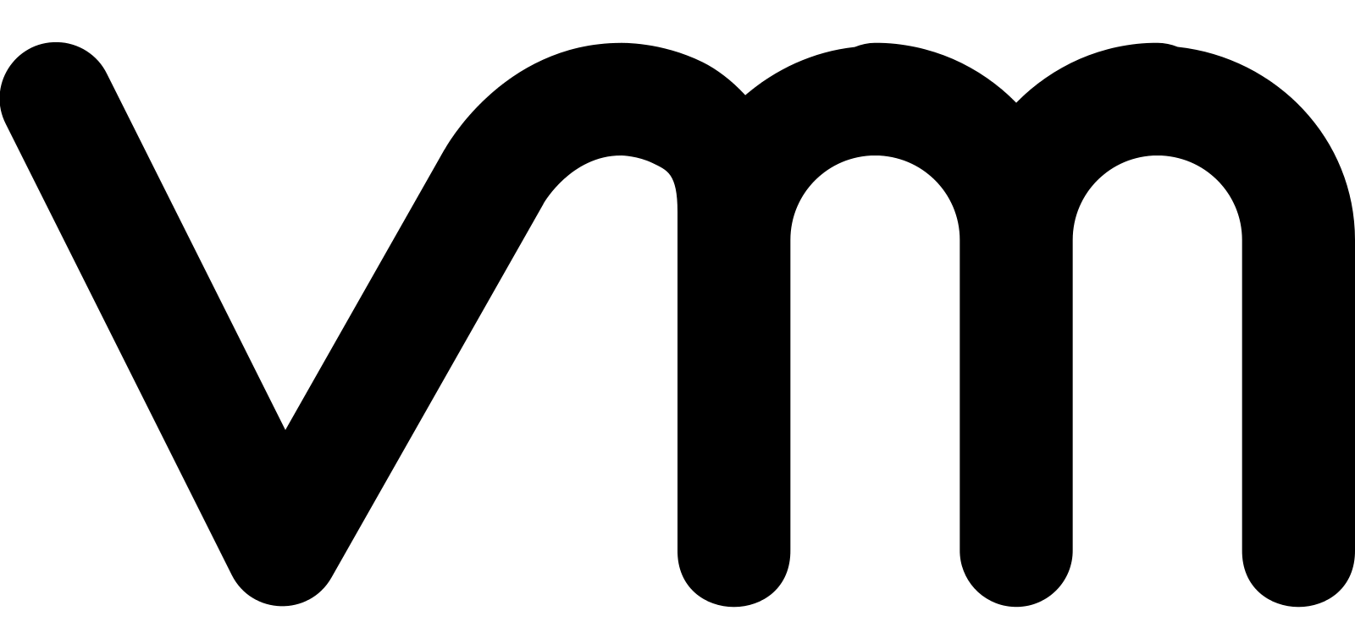











Possible Scenario on Huawei / Telefonica Cloud
Possible Scenario & Blockage on Baidu Cloud
Migration Patterns
Cloud to Cloud
Virtual to Cloud
OBS
Image Service
ECS
Database to Cloud
RDS Service
Storage to Cloud
AWS S3
Azure Blob
Huawei / Telefonica Object Storage
Google Storage
Alibaba OSS
Click2Cloud-ManageIQ-Telefonica
12

Slide 13
Thank you - Looking forward to hear your quires
At Click2Cloud Inc., we care about your growth. We combine the most suitable technologies with intellect and expertise to help customers meet their swiftly changing needs of global business models and dynamic requirements for sophisticated technology solutions to meet their business requirements.
Click2Cloud Headquarters
Click2Cloud India Office
Click2Cloud China Office
2549 152nd NE Ave, Redmond 98052, WA USA
Phone: +1-425-748-9666
Email: contact@click2cloud.net
Website: www.click2cloud.net
Plot No. 21, IT Park, Wing - A, 1st Floor, Gayatri Nagar, Nagpur, Maharashtra 440022
Phone: +91-7447405925
Email: contact@click2cloud.net
Website: www.click2cloud.net
North Taikoo Li, 11 Saniltun Road, TWR N3 3/F, Chaoyang, Beijing
Ph: 130 23185971 / 131 62780929
Email: contact@click2yun.com
Website: www.click2yun.com
Click2Cloud-ManageIQ-Telefonica
13

